Slide 1
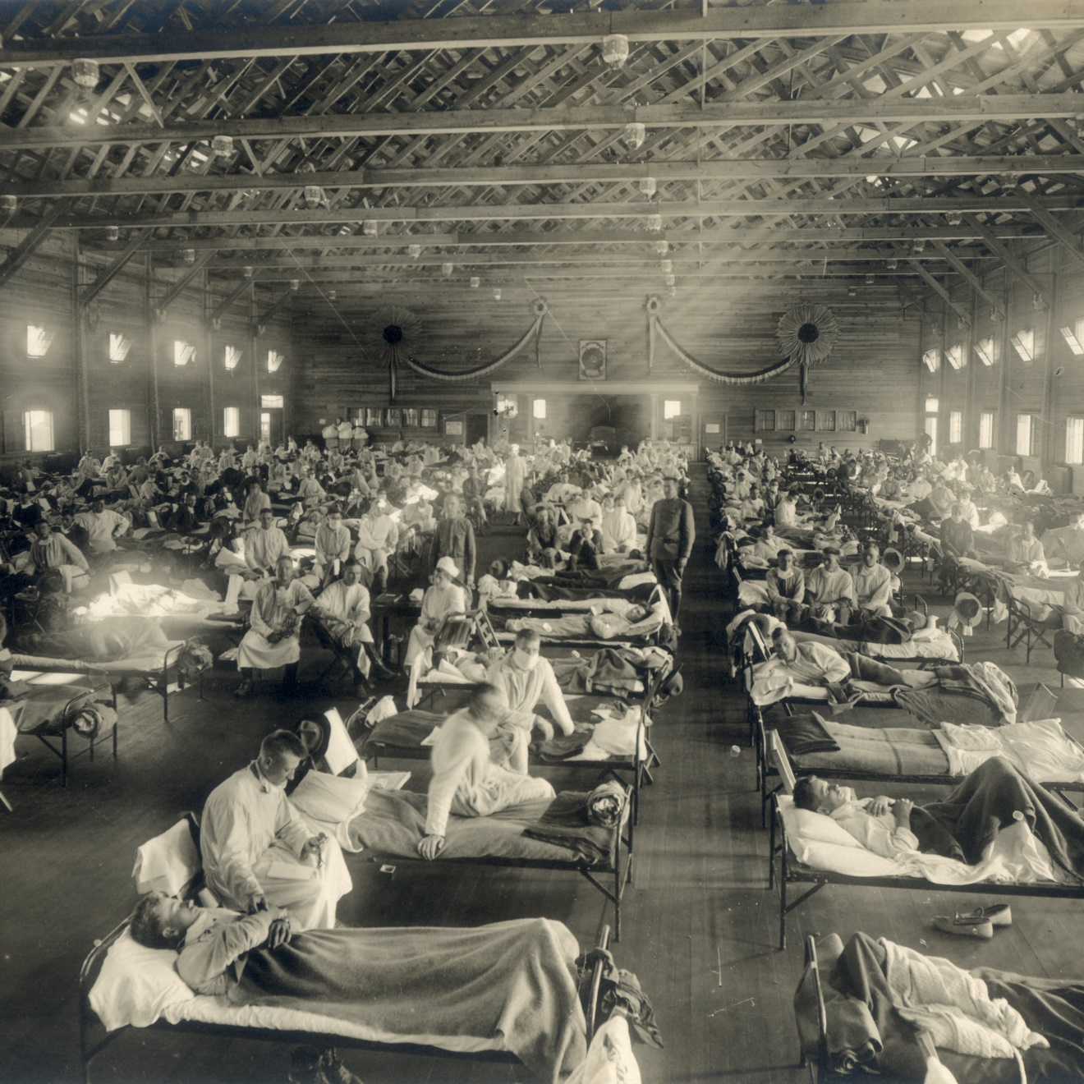

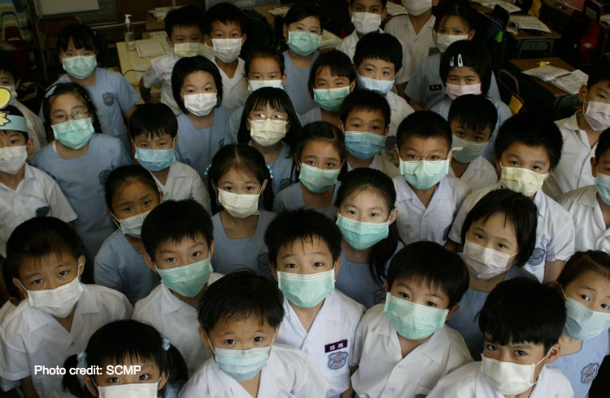
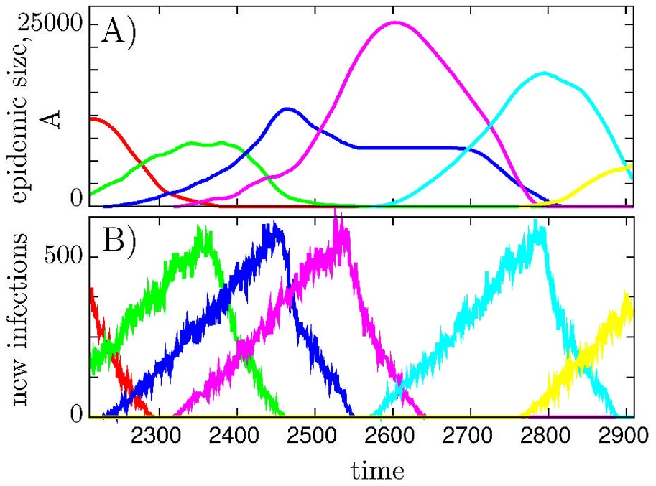
Epidemiology of Infectious Diseases
University of Bologna, Italy
Distant Learning Course
July 20th – August 7th 2020
Scientific Directors: Stephanie Factor, Paolo Boffetta
Rationale and goals
The COVID-19 pandemic raised an interest in epidemiology among health professionals, the media and the general public. Although most health professionals have experienced some training in the discipline during their education, they rarely apply epidemiology methods in their practice, and over time concepts may become confused and the ability to critically interpret results of surveys and observational studies may decrease. The recent exposure to epidemiological data, including results of studies, model-based predictions, and applications to health policy decisions, might stimulate in science-oriented health professionals the need for a refreshment and deepening of the principles and methods of infectious disease epidemiology. While an in-person summer class would have been a preferable format, the current situation convinced us to design a distant learning course, which we are confident would represent a useful training opportunity.
Faculty
Stephanie Factor, MD, PhD. She is Associate Professor at Icahn School of Medicine at Mount Sinai, USA, and former Official at US CDC. Dr. Factor combines a strong knowledge in the principles of infectious disease epidemiology with her exposure to disease outbreaks in New York City, and an extensive experience in teaching.
Paolo Boffetta, MD, MPH. He is Full Professor at Stony Brook University, USA, and at the University of Bologna, Italy, and a former Medical Officer at WHO. Dr. Boffetta is a senior epidemiologist with interest in method development.
Additional faculty members will be added at a later date.
Course content
The course will address basic concepts in epidemiology of infectious diseases and current issues in design, conduct and interpretation of studies and their contribution to causal inference in infectious disease medicine.
Topics include General Principles of infectious disease epidemiology, options for study design, outbreak epidemiology, infectious disease dynamics, vaccine development, healthcare-associated infections, advanced statistical modeling, meta-analyses, epidemiology of host immunity, prevention of infectious diseases, epidemiology of COVID-19.
No reference textbook is recommended for this course. Reading materials will be made available to course participants.
Language
The course will be held in English. No translation will be provided.
.
Target participants
Graduate and post-graduate students and junior faculty from schools of medicine, biology, dentistry, statistics, mathematics, social and health sciences are eligible, as well as residents in all medical disciplines
Timetable of the course
A total of nine sessions will be held every Monday, Wednesday and Friday between 4pm and 6pm CET; practical exercises will be assigned between lectures. The first session will take place on Monday, July 20th 2020 and the last session on Friday, August 7th 2020.
Pre-requisites
Some basic knowledge of epidemiology and statistics is required. A good command of both written and spoken English is required. Participants are required to have access to a computer during the course.
Administrative aspects
A tuition fee of € 200 include course materials, access to the lectures and the exercises.
A reduced fee of € 100 is reserved for the following applicants
• PhD and other graduate students; medical residents
• Applicants from low- and middle income countries, as defined by World Bank
Pre-applications should be submitted by sending a short CV and a brief statement of interest at infectious.diseases.epi@gmail.com before June 15th 2020. Applicants are selected on the basis of the curriculum and research experience.
Acceptance will be communicated by June 20th 2020 and registration with payment will be required by July 3rd 2020. Cancellations must be submitted by email to the secretariat. Refunds will include an administrative fee of € 50.
The Scientific Direction reserves the right to cancel the course if a minimum number of participants will not be reached.
Venue
The course will be conducted remotely through an online platform. Details will be communicated at a later date.
Secretariat
Ilaria Denti Pompiani, MD
Department of Medical and Surgical Sciences, University of Bologna
E-mail: infectious.diseases.epi@gmail.com

